Slide 1
LCT Gender Action Plan Validation Workshop
February 12, 2020
By Nitnida Phongsavath, NIU/DPC
Notes:
Her excellency, Minister
Ladies and gentlemen
Distinguished guests
On behalf of the NIU, I would like to present key results of the two recently closed projects, namely TDF II and EIF Tier II and priorities for FY 2019 of two new projects executed by NIU, including Lao Competitiveness and Trade Project funded by the World Bank, Australia, and Ireland, and Export Competiveness Promotion Project in Northern Laos funded by the Enhanced Integrated Framework.

Slide 2
Key Rational
Gender mainstreaming has potential to positively impact women’s economic empowerment and support the fight against poverty through job and income generation
Promoting gender equality is a core development objective for Lao PDR, especially by encouraging men and women to play an equal role in socioeconomic development and managing natural resources.
Project design recognized that attention needs to be paid to gender equality and women’s advancement.

Slide 3
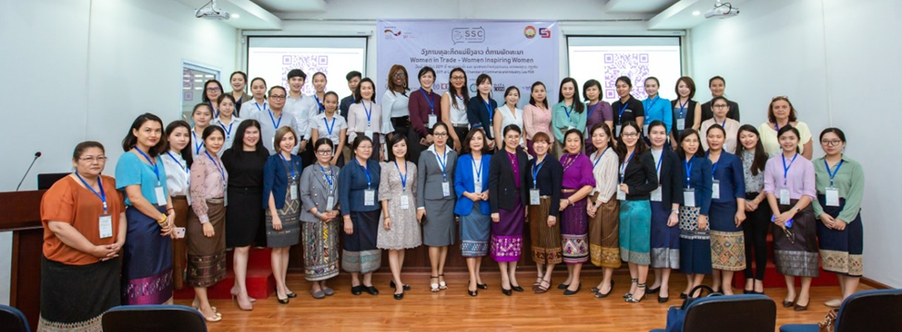
In line with Government’s Action Plan (2016-2020, this Strategy promotes gender equality, women’s competency and women advancement

Slide 4
Current Challenges
The percentage of firms with women as part of the ownership structure of firms:
  Significantly higher among small firms (55.3 per cent);
  Among medium and large firms (around 20 per cent)
  Although participation of women in ownership and management of firms is increasing;
  Only about a third of manufacturing firms have women as part of the ownership and only about a quarter of them have women as top managers
  businesses owned and managed by women are less likely to export, although the number is increasing
This suggests that female entrepreneurs may face problems accessing support and resources to expand their businesses, including better access to business networks, credit and management skills and others

Slide 5
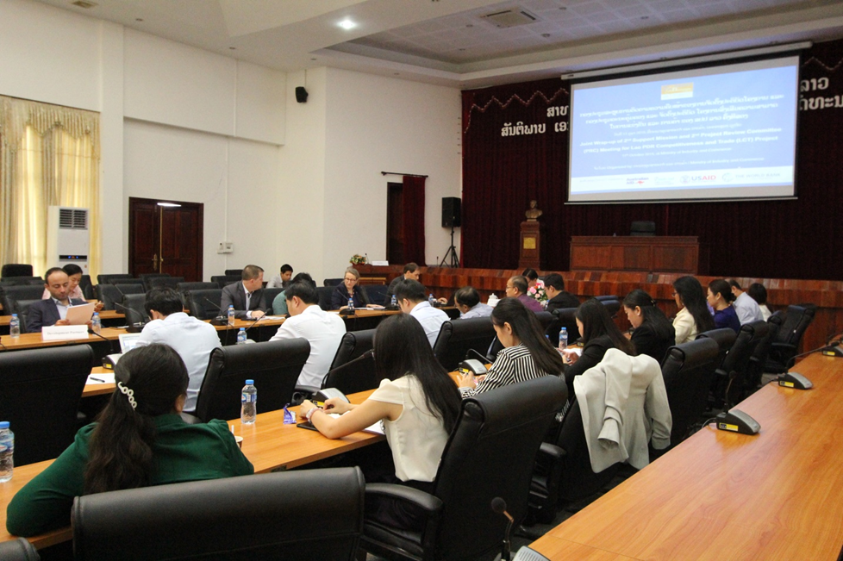
Objectives of the Gender Action Plan
Establish structures and processes that will promote effective mainstreaming of gender in the LCTP and other TRTA
Improve staff members appreciation, understanding, awareness and capacities to integrate gender in all aspects of their work
Notes:
The Strategy is designed to assist the National Implementation Unit (NIU) of the Department of Planning and Cooperation, Ministry of Industry and Commerce (MoIC) to implement the LCT in an inclusive and gender-sensitive manner. During Project design and preparation, it was recognized that despite impressive improvements in economic growth, especially in business and trade, attention needs to be paid to gender equality and women’s empowerment. Extensive research, studies and lessons learned suggest that women not only participate in a higher percentage of micro and small enterprises than men, but also play a crucial role in economic activities. However, there are only a few women entrepreneurs who hold medium-sized and larger firms in the Lao People’s Democratic Republic (Lao PDR).

Slide 6
Incorporate gender sensitivity in all levels
Development
Challenges
Pillars/Components
Intermediate Outcomes
Outcomes
Impacts
Complex business environment and limited regulatory transparency
High trade and transport costs
Weak design of policies and regulations
Weak and variable enforcement of law
Limited public-sector capacity
Modest investment in innovation by firms
Relatively few women entrepreneurs
Public-Private Dialogue is not inclusive
A. Improving the Business Environment
A.1 Making it Easier to Start a Business (a, c, d)
A.2 Streamlining and Publishing Operating Licenses (a, c, d)
A.3 Support to Broader Business Reforms (a, b, d, e)
Processes related to starting and operating a business are simplified and more predictable (A.1, A.2, A.3, B.1)
Reduced time and costs to start and operate a business
Increased investment and more jobs
Poverty reduction and greater inclusion
B. Facilitating Trade and Connecting to Markets
B.1 Supporting the Trade Facilitation Secretariat (b, c, e, h)
B.2 Trade Facilitation Agreement Challenge Facility (b, c, d)
Better coordination among regulatory and border agencies (B.1, B.2)
Lower time to import and export
More transparent and less burdensome regulations for trade (B.1, B.2, D.2)
C. Improving Firm-Level Competitiveness
C.1 Business Assistance Facility (f, g)
Private enterprises invest in business advisory services (C.1)
Increased firm competitiveness
D. Supporting Better and More Inclusive Policies
D.1 Project Management and Coordination (e)
D.2 Improved Policy Making and Transparency (a, c)
D.3 Supporting Public-Private Dialogue (g, h)
Better and more coherent policies and regulations are designed and implemented (A.1, A.2, A.3, B.2, D.2, D.3)
Critical assumptions:
Sustained commitment to reforms
Positive global economic environment
Greater focus on small, women-led, and rural enterprises (D.3)

Slide 7
Core Recommendations
  Conduct further study to identify factors that have direct or specific impact on women-owned and managed businesses and the employment of women;
  Systematically gather more gender-disaggregated data in major economic sectors to increase the awareness of the gender differentiated impact of trade liberalisation among business owners and managers and policy makers;
  Make extra efforts to monitor gender related indicators of the LCT Result framework through developing sub-indicators; and
  Incorporate gender sensitively in all pillars/components’ activities, including capacity-building.

Slide 8
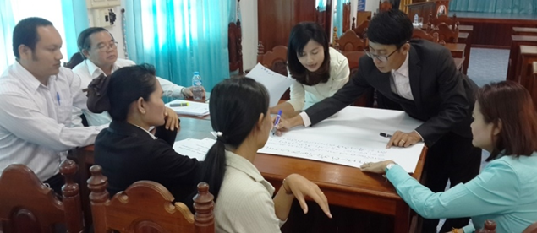
Actions for Pillar A -
Improving the Business Environment
Gender sensitivity will be mainstreamed into the following areas:
  Simplification of procedures for starting a business
  Selection of licenses and streamlining
  Simplification of regulations around DB Indicators
  Development and review of CF proposals
Outreach activities and related dissemination materials developed by DERM and others to raise awareness of procedures for starting a business and other DB regulations.
Gender specific indicators will be closely monitored as part of project progress review

Slide 9
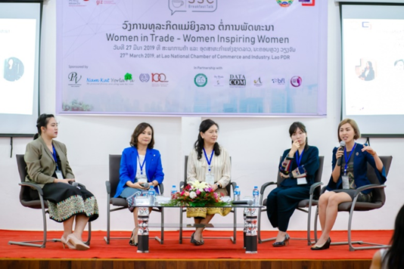
Actions for Pillar B –
Facilitating Trade and Connecting to Markets
Incorporate gender dimensions in the following areas:
  The discussion and development of guidelines and procedures for cross border trade;
  Review and development of CF Proposals;
  The working of National Trade Facilitation Committee (NTFC), its secretariat and various technical working groups such as NTM WG;
  Improve women led businesses’ representation in various structures of NTFC for example consider inviting lao Business Women Association among NTFC members;
  Closely monitor/update gender specific indicators as part of project progress review process.

Slide 10
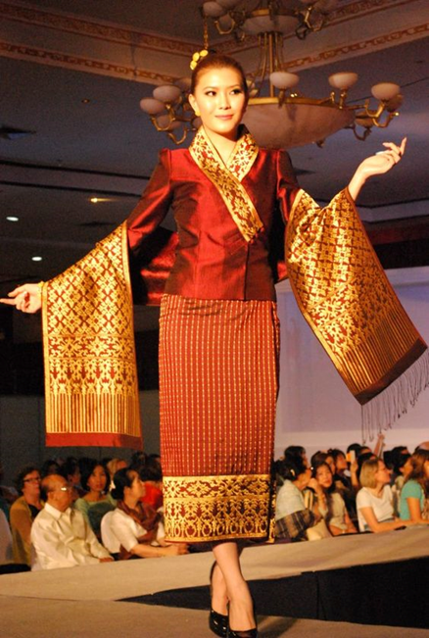
Actions for Pillar C -
Improving Firm-Level Competitiveness
Mainstream gender sensitivity in the following areas:
  Outreach activities and publicity materials
  Advisory services;
  Provision of 40% of grant proposals to women led businesses;
  Quarterly progress reports provide gender disaggregated data.

Slide 11
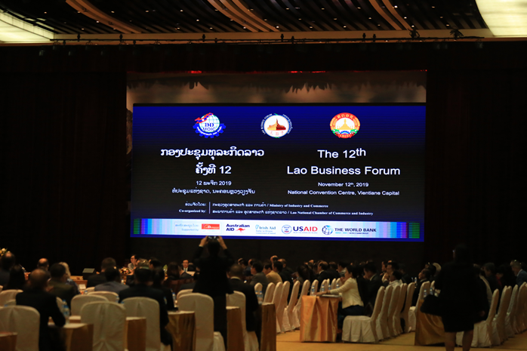
Actions for Pillar D-
Supporting Better and More Inclusive Policies
Support research and studies to gain better understanding about impact of trade policies on women owned/led businesses and employment of women;
Encourage participation of women entrepreneurs in various levels of PPD under LBF;
Track progress of resolving issues raised by women led businesses;
Support other donor funded projects in expanding PPD at local level with strong participation of women led businesses.

Slide 12
Implementation Arrangement
Validate and launch gender action plan during the first half of 2020
Mainstream gender actions in all pillars/components of the project
Appoint gender focal points in all key implementing agencies;
Conduct awareness raising and capacity building activities for all appointed focal points on quarterly basis;
Fully embed gender actions into project result monitoring and evaluation framework.

Slide 13
M&E and Reporting
Gender specific indicators will be monitored on quarterly, semi-annually and annual basis as part of overall project implementation monitoring process
With support from NIU team all implementing agencies will be required to provide NIU with information on gender specific indicators under their components;
Gender specific indicators will be updated in Gender Actions Completion Report, which will be a Chapter of the LCT Implementation Completion and Results Report.

Slide 14
M&E and Reporting
RESULT_FRAME_TBL_IO
Intermediate Results Indicators by Components | DLI | CRI | Unit of Measure | Baseline | Intermediate Targets | End Target
 |  |  |  |  | 1
Improving the business enviornment
Time to obtain ERC from DERM |  |  | Days | 14.00 |  | 5.00
Time for women-led enterprises as percent of men-led enterprises |  |  | Percentage | 100.00 |  | 100.00
Number of operating licenses streamlined |  |  | Number | 0.00 | 10.00 | 30.00
Number of operating licenses streamlined in sectors of particular interest to women |  |  | Number | 0.00 | 3.00 | 10.00
Procedures to start a business (women) |  |  | Number | 8.00 | 7.00 | 6.00
Number of new enterprise registrations per year |  |  | Number | 6,707.00 |  | 7,713.00
Faciliating trade and connecting to markets
Commitments under the Trade Facilitation Agreement implemented by Lao PDR |  |  | Percentage | 21.00 |  | 60.00
Technical Trade Facilitation Secretariat meetings with Private Sector Participation (last 12 months) |  |  | Number | 0.00 |  | 4.00
Mean time to clear imports, exports, and transit, through customs |  |  | Hours | 9.40 |  | 6.00
Improving Firm-Level Competitiveness
Total number of grants disbursed |  |  | Number | 0.00 |  | 300.00
Grants to women-led enterprises |  |  | Percentage | 0.00 |  | 40.00
Supporting Better and More Inclusive Policies
Lao Business Fora held per year |  |  | Number | 1.00 |  | 1.00
Issues captured and actioned through the Lao Business Forum that have been raised by women-led enterprises |  |  | Percentage | 33.30 |  | 40.00
Perception of Lao Business Forum’s effectiveness |  |  | Text | Very effective 31 percent |  | 40.00
Hits on the Lao Trade Portal |  |  | Number (Thousand) | 370.60 |  | 400.00

Slide 15
Thank You

