Slide 1
Gender and COVID-19 Pandemic
NIU Learning event
April 23, 2020

Slide 2
Objective
To gain better understanding about women’s leading role in the fight against Coronavirus

Slide 3
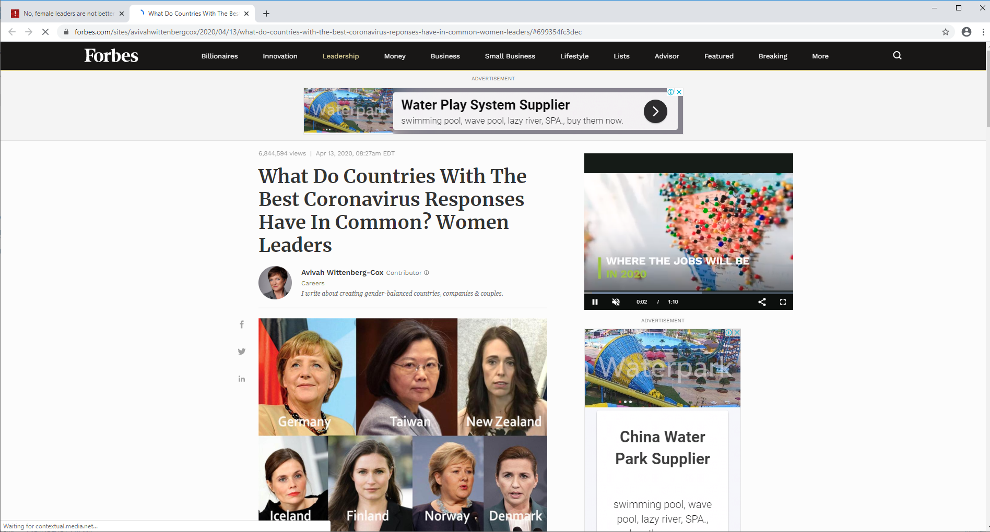
What Do Countries With The Best Coronavirus Responses Have In Common? Women Leaders

Slide 4
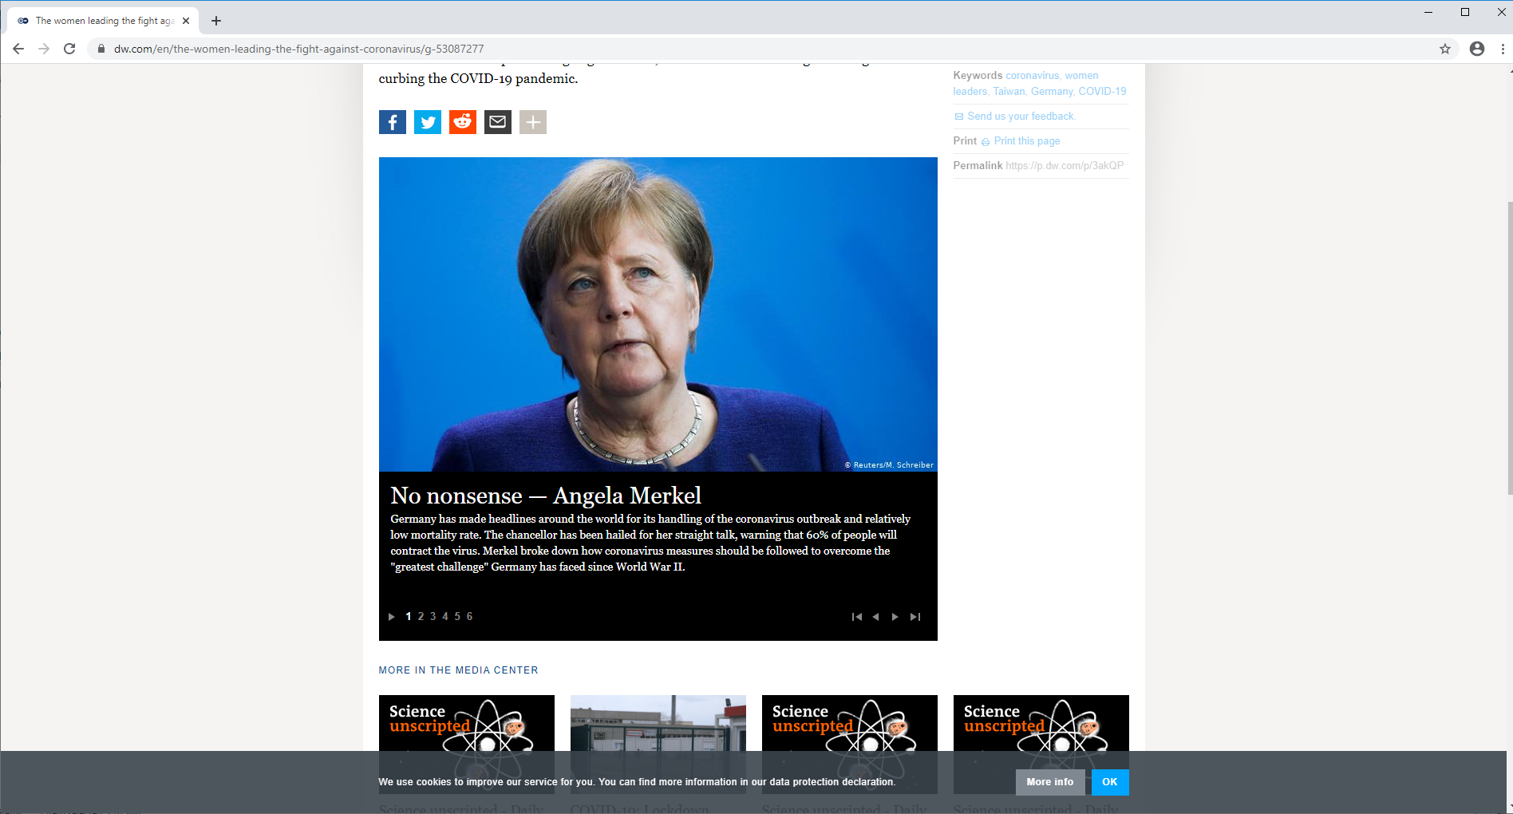
Germany has made headlines around the world for its handling of the coronavirus outbreak and relatively low mortality rate. The chancellor has been hailed for her straight talk, warning that 60% of people will contract the virus. Merkel broke down how coronavirus measures should be followed to overcome the "greatest challenge" Germany has faced since World War II.

Slide 5

Developing vaccines — Marylyn Addo
The virologist and leading professor at the German Center for Infection Research and the head of infections at the Medical Center Hamburg-Eppendorf is working together with her team to develop a coronavirus vaccine. She has already developed vaccines against the Ebola virus and the MERS coronavirus.

Slide 6
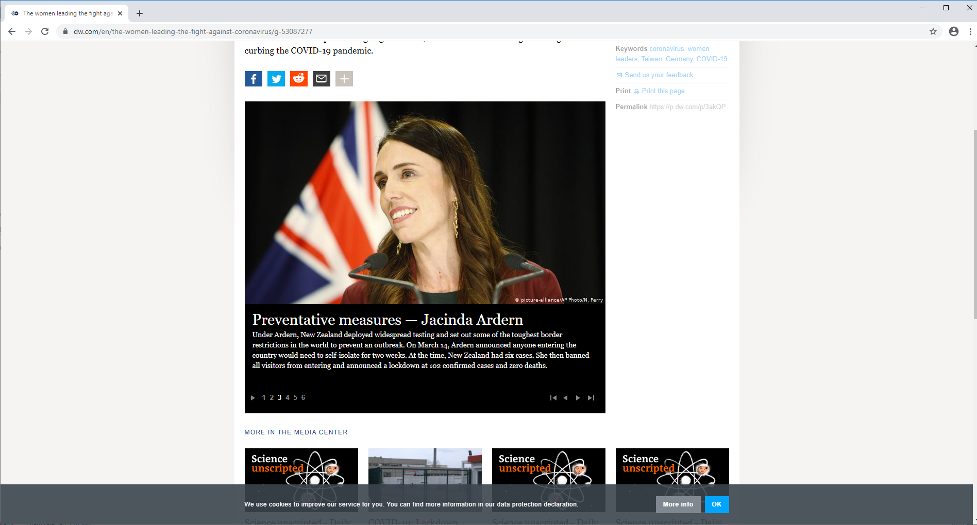
Preventative measures — Jacinda Ardern
Under Ardern, New Zealand deployed widespread testing and set out some of the toughest border restrictions in the world to prevent an outbreak. On March 14, Ardern announced anyone entering the country would need to self-isolate for two weeks. At the time, New Zealand had six cases. She then banned all visitors from entering and announced a lockdown at 102 confirmed cases and zero deaths.

Slide 7
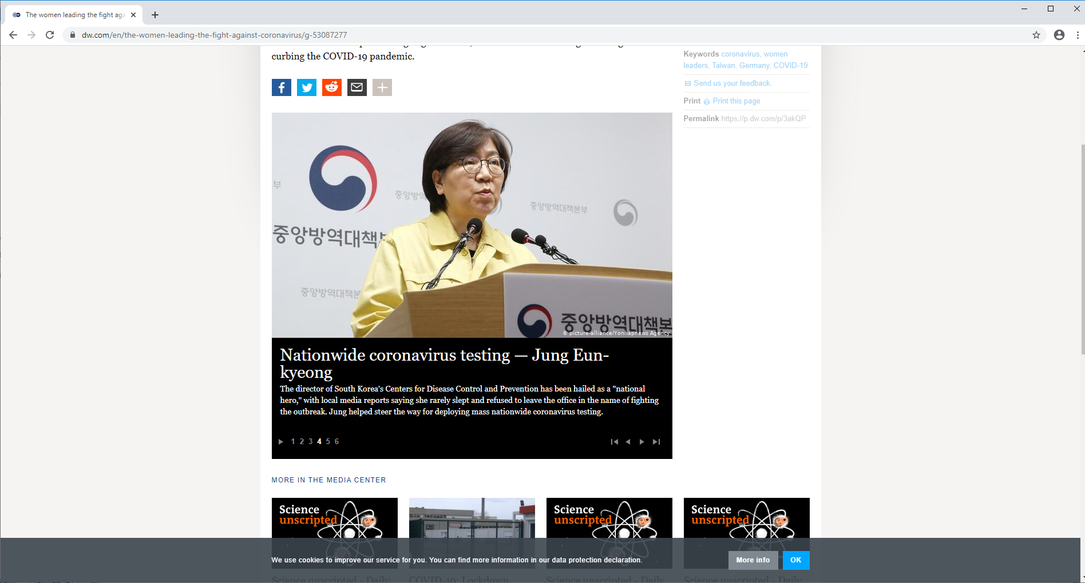
Nationwide coronavirus testing — Jung Eun-kyeong
The director of South Korea's Centers for Disease Control and Prevention has been hailed as a "national hero," with local media reports saying she rarely slept and refused to leave the office in the name of fighting the outbreak. Jung helped steer the way for deploying mass nationwide coronavirus testing.

Slide 8
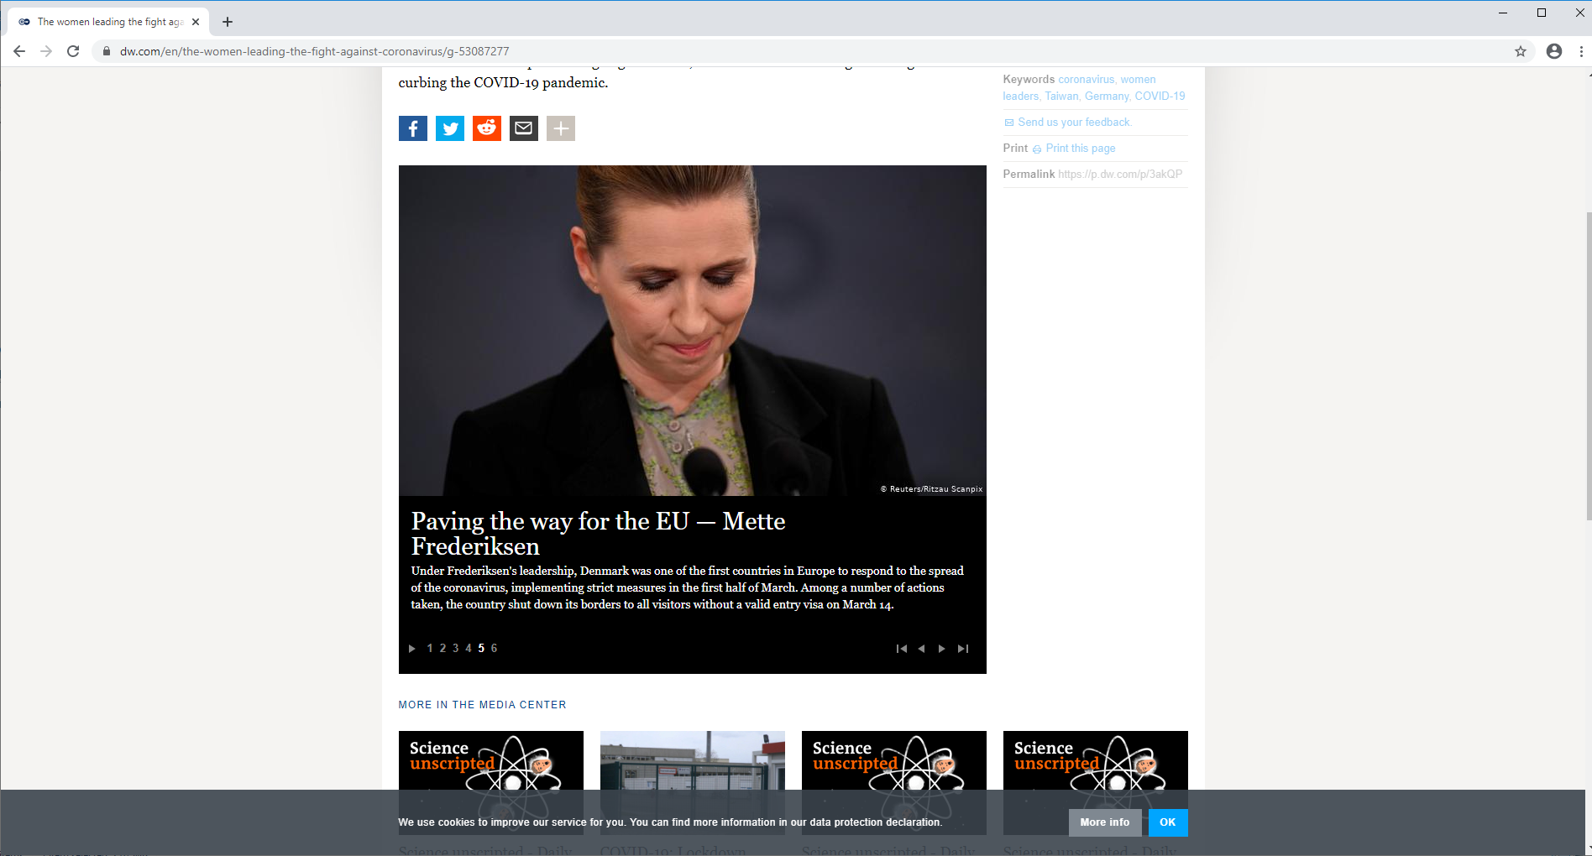
Paving the way for the EU — Mette Frederiksen
Under Frederiksen's leadership, Denmark was one of the first countries in Europe to respond to the spread of the coronavirus, implementing strict measures in the first half of March. Among a number of actions taken, the country shut down its borders to all visitors without a valid entry visa on March 14.

Slide 9
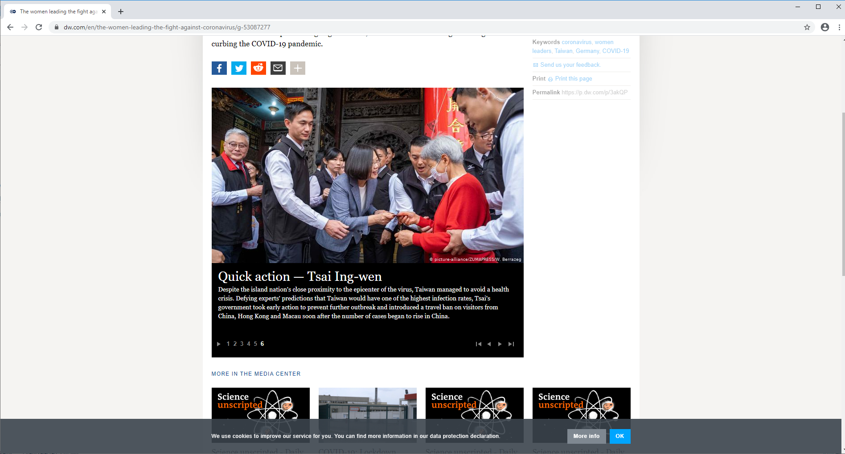
Quick action — Tsai Ing-wen
Despite the island nation's close proximity to the epicenter of the virus, Taiwan managed to avoid a health crisis. Defying experts' predictions that Taiwan would have one of the highest infection rates, Tsai's government took early action to prevent further outbreak and introduced a travel ban on visitors from China, Hong Kong and Macau soon after the number of cases began to rise in China.

Slide 10
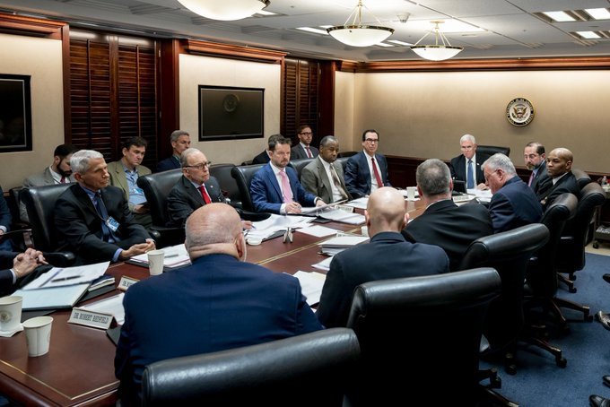

Slide 11
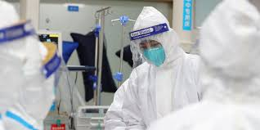
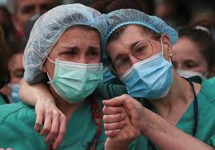
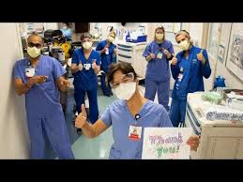
Women comprise the majority of frontline healthcare workers globally, meaning that female representation is vital in tackling the coronavirus crisis.
70% of the world's healthcare staff are made up of women, but only 25% of global leaders are female.
Without women in these positions, women's issues could fail to be addressed throughout the crisis.

Slide 12
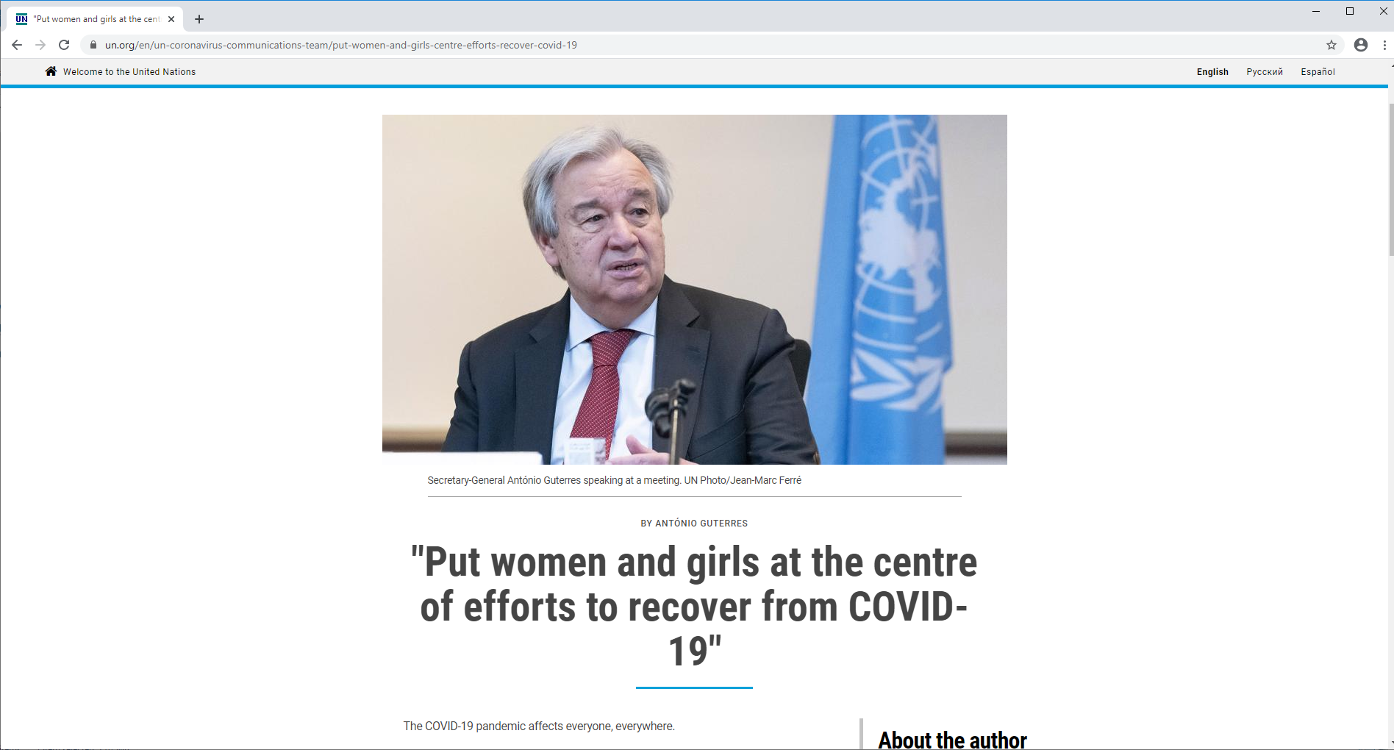

Slide 13
The secret weapon in the fight against coronavirus: women
….“Correlation is obviously not causation. Being a woman doesn’t automatically make you better at handling a global pandemic. Nor does it automatically make you a better leader”
…”What is true, however, is that women generally have to be better in order to become leaders; we are held to far higher standards than men. Women are rarely able to fail up in the way men can; you have to be twice as good as a man in order to be taken half as seriously. You have to work twice as hard.”

Slide 14
Thank You
Notes:
This brings to the conclusion of my presentation. I am happy to address any questions/ issues you may have.
Thank you for your attention.

